Slide 1
CS 2212
Introduction to Software Engineering
Chapter 14 Pattern Based Design

Slide 2
Copyright Notice This Presentation and Its Associated Video Contain Copyright Material. This Presentation and Its Associated Video Are Provided for Teaching Purposes of CS2212 and Should Not Be Posted In Any External Site, Or Shared with. This Presentation and Its Associated Video Are Provided For Instructional Personal Use Only, and Only For The Purposes of the CS2212 Course.

Slide 3
Part 36
Data Oriented Repository Architectural Style
Before software can be reusable it first has to be usable.
― Ralph Johnson.
Notes:
This lesson introduces the basic steps in a software engineering project at a high level.
In practice, steps often overlap.

Slide 4
Learning Objectives in this Part
To understand the architectures under the Data-Oriented Repository architectural style family

Slide 5
Overview
Architectural styles and patterns
Data flow
Call-and-return
Interacting processes
Data-oriented repository
Transactional Databases
Blackboard
Hierarchical
Other
Heterogeneous architectures

Slide 6
Data-Oriented Repository
Characterised by a central data store component representing systems state and a collection of independent components that operate on the data store.
Connections between data store and external components vary considerably in this style:
Transactional databases: Incoming stream of transactions trigger processes to act on data store. Passive.
Blackboard architecture: Current state of data store triggers processes. Active.

Slide 7
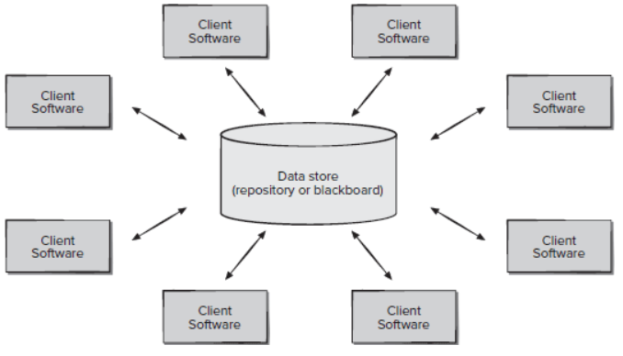
Transactional Databases
A data store (e.g., a file or database) resides at the center of this architecture and is accessed frequently by other components that Create, Read, Update and Delete (referred to as CRUD operations) data within the store.
Client software accesses a central repository. In some cases, the data repository is passive. That is, client software accesses the data independent of any changes to the data or the actions of other client software.
A variation on this approach transforms the repository into a “blackboard” that sends notifications to client software when data of interest to the client changes.

Slide 8
Blackboard
Characteristics: cooperating ‘partial solution solvers’ collaborating but not following a pre-defined strategy.
Current state of the solution stored in the blackboard.
Processing triggered by the state of the blackboard.
Knowledge
Source 1
Knowledge
Source 6
Knowledge
Source 2
Blackboard
(shared data)
Knowledge
Source 5
Knowledge
Source 3
Knowledge
Source 4

Slide 9
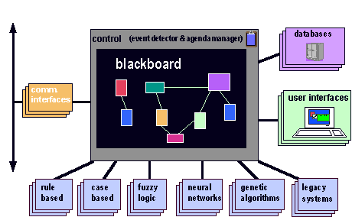
Blackboard Architectural Style Example
…………….
Knowledge Sources /
Problem Solving Strategies
http://www.nb.net/~javadoug/bb.htm

Slide 10
Examples of Blackboard Architectures
Problems for which no deterministic solution strategy is known, but many different approaches (often alternative ones) exist and are used to build a partial or approximate solution.
AI: vision, speech and pattern recognition, agent coordination

Slide 11
Part 37
Hierarchical Architectural Style
Optimism is an occupational hazard of programming: feedback is the treatment.
― Kent Beck.
Notes:
This lesson introduces the basic steps in a software engineering project at a high level.
In practice, steps often overlap.

Slide 12
Learning Objectives in this Part
To understand the Hierarchical Architectural Style

Slide 13
Overview
Architectural styles and patterns
Data flow
Call-and-return
Interacting processes
Data-oriented repository
Hierarchical
Interpreter
Layered
Tiered
Other
Heterogeneous architectures

Slide 14
Interpreter
Architecture is based on a virtual machine produced in software
Special kind of a layered architecture where a layer is implemented as a true language interpreter
Components: are ‘programs’ being executed, its data, the interpretation engine, and its state
Connectors: are the triggers (e.g. calls) to pass information from the “model” component (i.e. the program, its state, input data) to the “interpreter” component (i.e. the engine or the executor)
Example: Java Virtual Machine. Java code translated to platform independent bytecodes. JVM is platform specific and interprets (or compiles - JIT) the bytecodes.

Slide 15
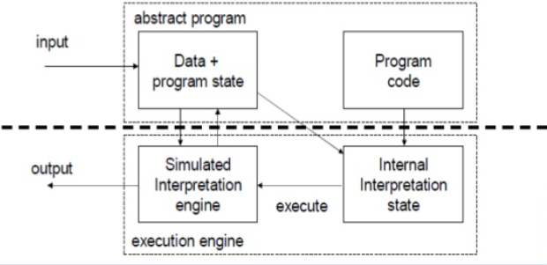
Interpreter Example
https://pt.slideshare.net/reejasr/architectural-styles-3

Slide 16
Layered Systems
“A layered system is organised hierarchically, each layer providing service to the layer above it and serving as a client to the layer below.” (Garlan and Shaw)
Each layer collects services at a particular level of abstraction.
In a pure layered system: Layers are hidden to all except adjacent layers.

Slide 17
Layered Systems
“Onion Skin model”…
corresponds to a stack of layers.
Components
Composites of
various elements
Useful Systems
Basic Utilities
Core
Level
Connectors
Usually
procedure
calls
Useful Systems
Basic Utilities
Core Level

Slide 18
Hierarchical systems
Hierarchical systems can be tree-like in general

Slide 19
Layered Systems
Applicability
A large system that is characterised by a mix of high and low level issues, where high level issues depend on lower level ones.
Components
Group of subtasks which implement a ‘virtual machine’ at some layer in the hierarchy
Connectors
Protocols / interface that define how the layers will interact

Slide 20
Layered Systems
Invariants
Limit layer (component) interactions to adjacent layers (in practice this may be relaxed for efficiency reasons)
Typical variant relaxing the pure style
A layer may access services of all layers below it
Common Examples
Communication protocols: each level supports communication at a level of abstraction, lower levels provide lower levels of communication, the lowest level being hardware communications.

Slide 21
Layered System Examples
Example 1: ISO defined the OSI 7-layer architectural model with layers: Application, Presentation, …, Data, Physical.
Protocol specifies behaviour at each level of abstraction (layer).
Each layer deals with specific level of communication and uses services of the next lower level.
Example 2: TCP/IP is the basic communications protocol used on the internet. POSA book describes 4 layers: ftp, tcp, ip, Ethernet. The same layers in a network communicate ‘virtually’.
Example 3: Operating systems e.g. hardware layer, …, kernel, resource management, … user level “Onion Skin model”.
...

Slide 22
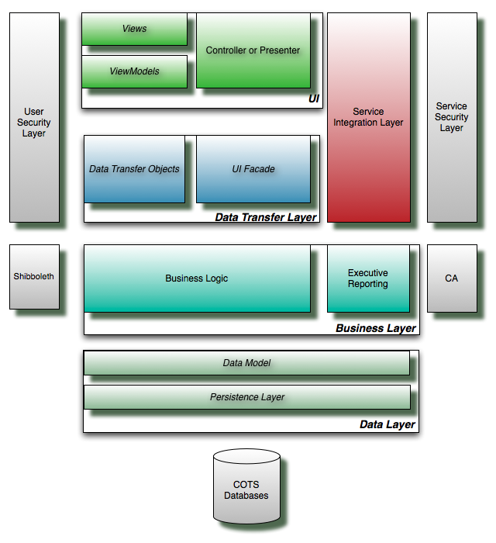
Example Layered Co-Op System

Slide 23
Layered Systems
Strengths
Increasing levels of abstraction as we move up through layers – partitions complex problems
Maintenance - in theory, a layer only interacts with layers above and below. Change has minimum effect.
Reuse - different implementations of the same level can be interchanged
Standardisation based on layers e.g. OSI

Slide 24
Layered Systems
Weaknesses
Not all systems are easily structured in layers (e.g., mobile robotics)
Performance - communicating down through layers and back up, hence bypassing may occur for efficiency reasons
Similar strengths to data abstraction / OO but with multiple levels of abstraction (e.g. well-defined interfaces, implementation hidden)
Similar to pipelines, e.g., communication with at most one component at either side, but with richer form of communication
A layer can be viewed as aka “virtual machine” providing a standardized interface to the one above it

Slide 25
Tiered Architectures
Special kind of layered architecture for enterprise applications
Evolution
Two Tier
Three Tier
Multi Tier

Slide 26
Two Tier Client Server Architecture Design
Developed in the 1980s to decouple (typically form/based) user interface from the storage of data.
Improved maintainability (changes to UI and database can be made independently); Scales up to 100 users
See http://www.sei.cmu.edu/str/descriptions/twotier.html#512860
Client tier
User System Interface
+ Some Processing
Management
Server tier
Database Management
+ Some Processing
Management

Slide 27
Three Tier Client Server Architecture Design
Emerged in the 1990s to overcome the limitations of the two tier architecture by adding an additional middle tier.
This middle tier provides process management where business logic and rules are executed and can accommodate hundreds of users by providing generic services such as queuing, application execution, and database staging.
An effective distributed client/server design that provides increased performance, flexibility, maintainability, reusability, and scalability, while hiding the complexity of distributed processing from the user.
See http://www.sei.cmu.edu/str/descriptions/threetier.html

Slide 28
Three Tier Client Server Architecture Design
User System Interface
Processing Management
Database Management

Slide 29
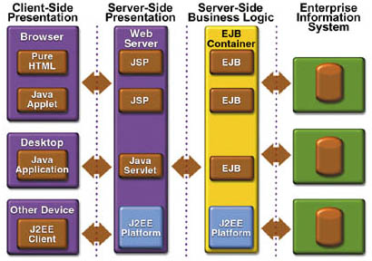
Example of a Multi Tier Architecture: Java 2 Platform, Enterprise Edition (J2EE)

Slide 30
Part 38
Heterogeneous Architectures
Good judgment comes from experience, and experience comes from bad judgment.
― Frederick P. Brooks.
Notes:
This lesson introduces the basic steps in a software engineering project at a high level.
In practice, steps often overlap.

Slide 31
Learning Objectives in this Part
To understand the concept of Heterogeneous Architectures

Slide 32
Overview
Architectural styles and patterns
Data flow
Call-and-return
Interacting processes
Data-oriented repository
Hierarchical
Other
Heterogeneous architectures
Hierarchical heterogeneous
Location heterogeneous
Simultanesously heterogeneous

Slide 33

Hierarchical Heterogeneous
Hierarchical heterogeneous: The whole system can be viewed macroscopically as being designed in one architecture style but the internal design of a component may conform to a completely different style (e.g., layered architecture overall, but internally designed in OO style)
Business Logic
<<uses>>
Internship Position
Subsystem
Student Services Subsystem
Student Record.
Subsystem
Grading
Subsystem
<<uses>>
Financial Services Subsystem
Accounting
Subsystem
Insurance
Subsystem

Slide 34
Locational Heterogeneous
Locational heterogeneous: Overall architecture at same level is a combination of different styles (e.g., repository (database) and layered, etc.)
Data Layer
Data Model
Persistence Layer
Query Manager
Adapter1
Adapter 2
Adapter 3
COTS DB
COTS DB
COTS DB
34

Slide 35
Simultaneously Heterogeneous
Simultaneously heterogeneous: The system can be described by different architecture styles at the same time based on the perspective we view the system

Slide 36
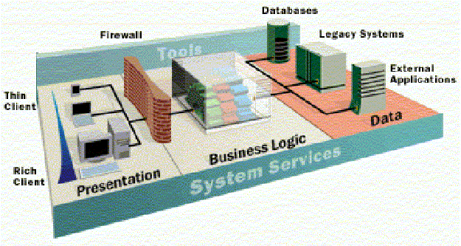
Example of Heterogeneous Architectures: Enterprise Architectures
Multi tier (at the highest level), distributed (including broker pattern), transactional databases, event-based communication, implicit invocation, object-oriented, MVC (e.g., for presentation in the client), dataflow for workflow, etc.

Slide 37
Your Turn
Discuss the differences between the Transactional Data Bases architecture and Blackboard architecture.
Discuss the differences, and possible similarities, between Blackboard architecture and Implicit Invocation architecture.
Provide two examples of systems for which a tiered architecture will be most suitable for. Explain the functionality of each tier used in your examples.
Check-out the content of the following sites:
https://aws.amazon.com/event-driven-architecture/
https://en.wikipedia.org/wiki/Blackboard_system
https://en.wikipedia.org/wiki/Multitier_architecture
https://www.thinktocode.com/2018/07/05/layered-architecture/

